Slide 1


The Bigger Picture
INSIGHTS INTO THE REPORT
Pauline Norstrom, CEO Anekanta Consulting
Honorary Member and Former Chair
The British Security Industry Association

Slide 2
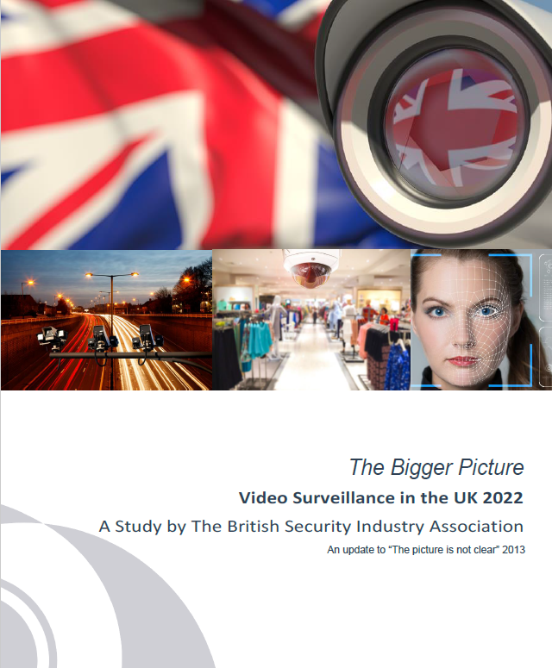
Background
The report, titled ‘The Bigger Picture’ is an extensive update to the BSIA's research report of 2013, ‘The Picture is Not Clear’, which has been quoted by the trade and mainstream media worldwide, the quality of which has never been surpassed in the intervening time

Slide 3

To reveal at IFSEC International
Total number of professional video surveillance cameras in use in the UK
The public vs private sector ratio
Use of video surveillance cameras as a data source
Adoption of AI and facial recognition software

Slide 4
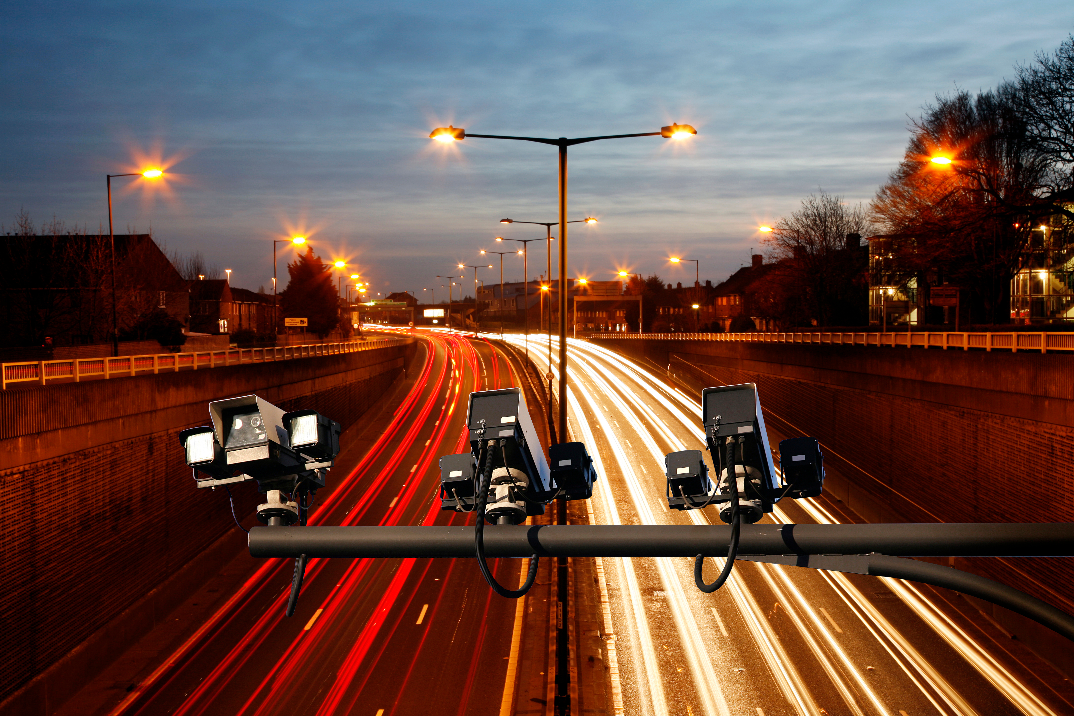
The journey –methodology
Surveys of BSIA members and industry specialists
Technology and trends. Use of AI, local and cloud storage
Insights into future upgrade plans
2013
6 million cameras
2021 BSIA Members input into the research questions
Cameras per building type Retail, Industrial, Office
End user primary research 11 sectors

Slide 5

2022
Total number of professional video surveillance cameras in use in the UK
21.1 MILLION

Slide 6
Public vs Private Sector Ratio
“Although the number of cameras in the public sector has increased since 2013 this area remains chronically underfunded”
“Private sector use has grown 300% since 2013”
“99% of cameras remain in the private sector”

Slide 7
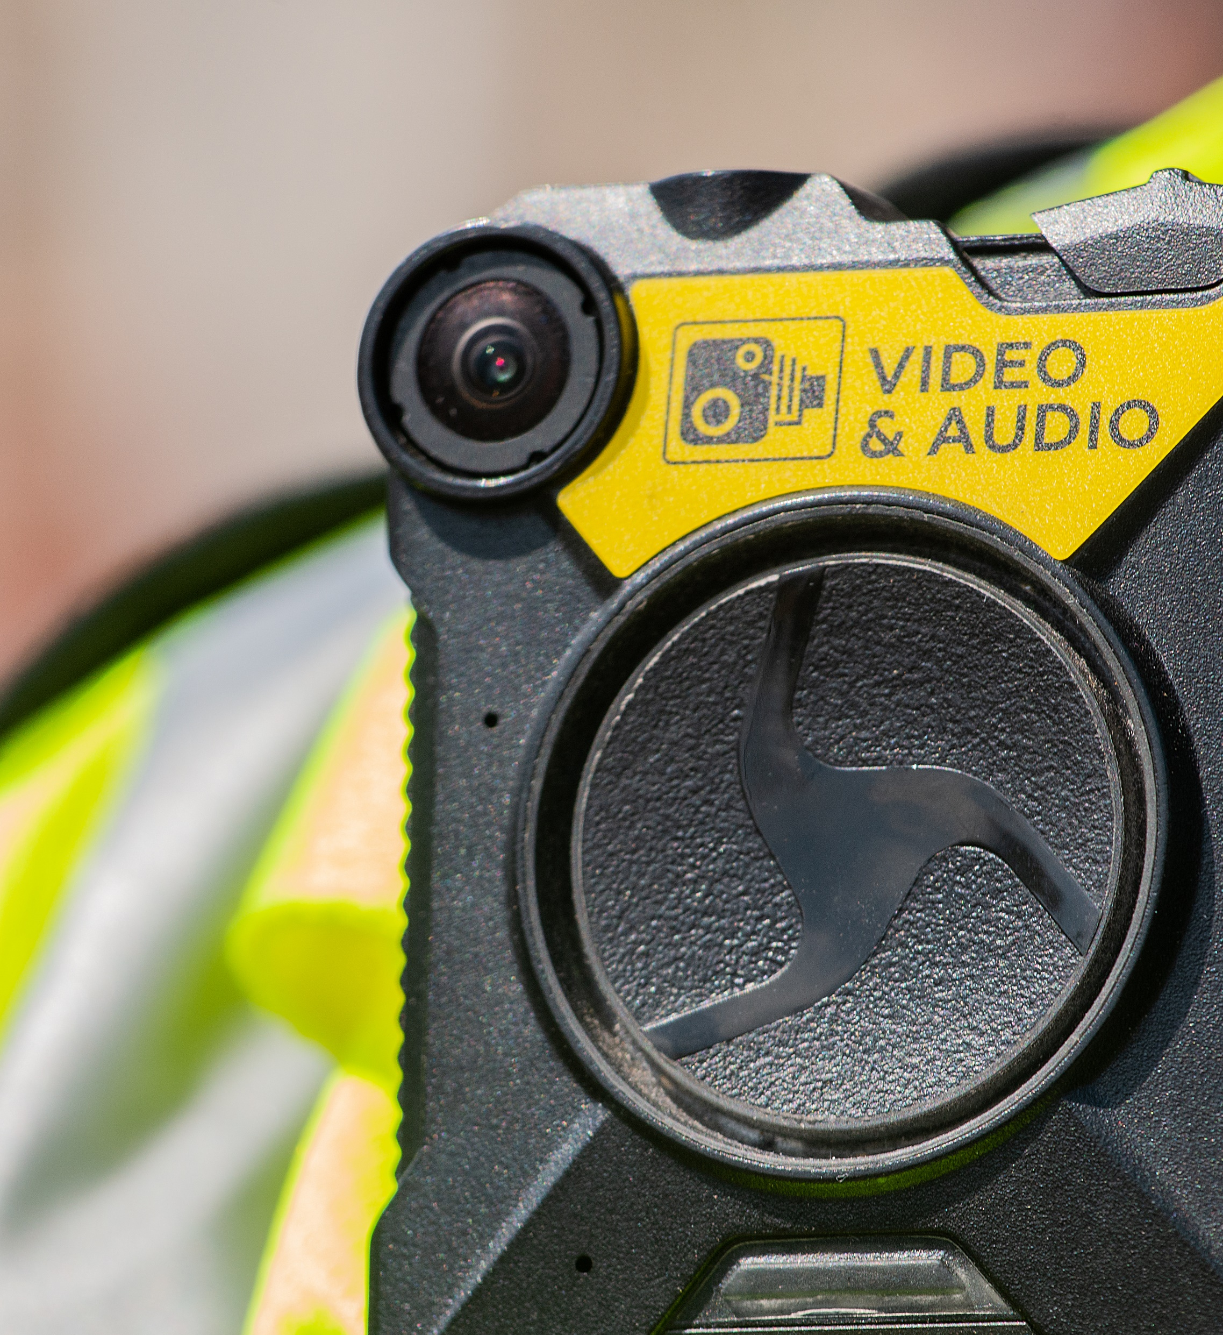

Use of video surveillance cameras as a data source
OVER 70% PRIVATE SECTOR CAMERAS USED FOR SOME FORM OF CRIME PREVENTION
THE REMAINING CAMERAS ARE USED FOR BUSINESS PURPOSES
INCREASING INTEGRATION INTO OPERATIONAL PROCESS
COMBINED WITH AI VIDEO SURVEILLANCE DATA IS SEEN AS ANOTHER IOT DATA SOURCE
THE VOICE OF THE PROFESSIONAL SECURITY INDUSTRY

Slide 8

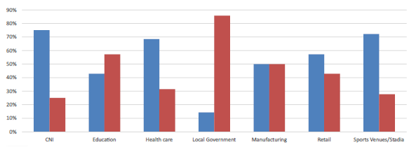
Adoption of AI and facial recognition software
THE USE OF FACIAL RECOGNITION SOFTWARE FOR ACCESS CONTROL IS GROWING
2% OF END USER DEPLOYMENTS USE SOME FORM OF FACIAL RECOGNITION
53% OF USERS SAID THEY WOULD BE USING AI WITH THEIR CAMERAS IN THE
FUTURE

Slide 9
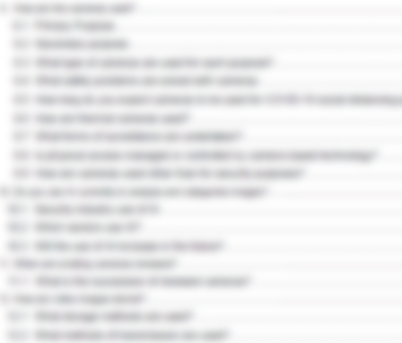
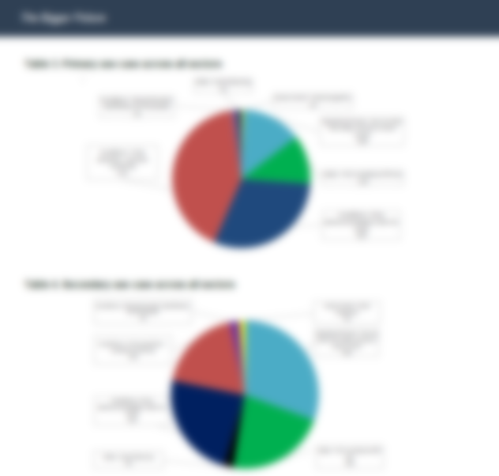
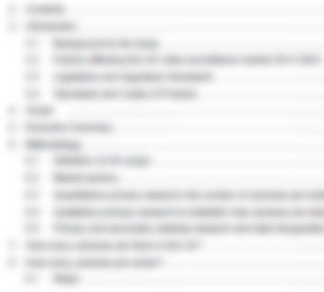
Want to know more?
The full report includes a detailed analysis of the types of cameras used and for what purpose, cloud storage trends and a comprehensive study of end user applications and future trends across 11 sectors including retail, transportation and CNI

